Slide 1
Linked Data Enrichment
“On the fly” and “Permanent”
Yoel Kortick | May 2026

Slide 2
Agenda
Introduction
Enrichment Types
On the Fly Enrichment
Permanent Enrichment

Slide 3

Introduction

Slide 4
Introduction
Institutions can customize linked data enrichment for MARC records by selecting the authorities they wish to enrich and designate the appropriate subfield ($0 / $1).
Additionally, institutions can opt to incorporate Virtual International Authority File (VIAF) URIs and include supplementary authorities for enrichment, such as local authorities supporting URIs (Uniform Resource Identifiers).
This enables institutions to exercise enhanced control over the linked data enrichment process for MARC records.
In addition to this presentation, it is recommended to see Linked Data Enrichment Configuration.

Slide 5
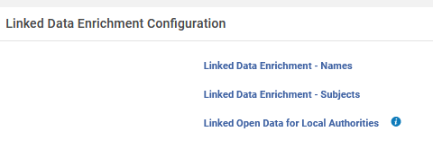
Introduction
The enrichment process is configured by accessing “Linked Data Enrichment Configuration” at “Configuration > Resources > General”.
There are separate tables for Names, Subjects and Local Authorities

Slide 6
Introduction
For name and subject authorities, the following configurations are available:
  Enable/Disable the row
  Vocabulary Source Code
  Authority URI
  Subfield for URI
  Add VIAF Link
  Subfield for VIAF
  Enrichment Type
Users can add rows for additional authorities (local or Community Zone) where they manually add the Alma source code and the VIAF source code.

Slide 7
Enrichment Types

Slide 8
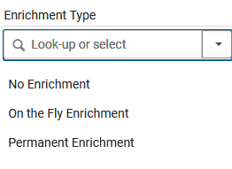
Enrichment Types
There are two Enrichment Types:
  On the Fly
  Permanent

Slide 9
Enrichment Types
On the Fly Enrichment
  Adds the URI to the headings of the record during export (via the General Publishing Profile)
Permanent Enrichment
  Adds the URI to the headings of the record permanently in the repository

Slide 10
On the Fly Enrichment

Slide 11
On the Fly Enrichment
We will now do an example of “On the Fly” enrichment.
In order to see how it works we will do as follows:
  See our definitions in the configuration tables for “Linked Data Enrichment – Names” and “Linked Data Enrichment – Subjects”
  Look at a set of three records and see that there are no linked data URI’s in the records
  Publish the set using the General Publishing Profile
  Look at the output file of the General Publishing Profile and see that the URIs have been added to the records in the output file but not to the records in the repository.

Slide 12
On the Fly Enrichment
Here is what we have defined for “Linked Data Enrichment – Names”.
Relevant rows of the table appear on the next slide
For vocabulary code GND (Deutschen Nationalbibliothek) we are adding the URI to subfield 0 and adding the VIAF link to subfield 1.
  We are using authority URI https://d-nb.info/{0} (the value in the curly brackets is the identifier of the authority record)
For vocabulary code LCNAMES (Library of Congress Names) we are adding the URI to subfield 0 and adding the VIAF link to subfield 1
  We are using authority URI http://id.loc.gov/authorities/names/{0} (the value in the curly brackets is the identifier of the authority record)

Slide 13
On the Fly Enrichment
Here is what we have defined for “Linked Data Enrichment – Names”.
The Enrichment Type is “On the Fly” for both Vocabulary Source Codes
The URIs will have the relevant URL from here and then the identifier

Slide 14
On the Fly Enrichment
Here is what we have defined for “Linked Data Enrichment – Subjects”.
Relevant rows of the table appear on the next slide
For vocabulary code GND (Deutschen Nationalbibliothek) we are adding the URI to subfield 0
  We are using authority URI https://d-nb.info/{0} (the value in the curly brackets is the identifier of the authority record)
For vocabulary code LCSH (Library of Congress Subject Headings) we are adding the URI to subfield 0
  We are using authority URI http://id.loc.gov/authorities/subjects/{0} (the value in the curly brackets is the identifier of the authority record)
For vocabulary code EUROVOC (European Union Vocabularies) we are adding the URI to subfield 0
  We are using authority URI http://eurovoc.europa.eu/{0} (the value in the curly brackets is the identifier of the authority record)

Slide 15

On the Fly Enrichment
Here is what we have defined for “Linked Data Enrichment – Subjects”.
The URIs will have the relevant URL from here and then the identifier
The Enrichment Type is “On the Fly” for all three Vocabulary Source Codes

Slide 16
On the Fly Enrichment
The three records in the set which we will publish are:
  Treasured Polish songs : with English translations (MMS ID 99603910800121)
  Food culture and literary imagination in early modern Italy : the renaissance of taste / Laura Giannetti. (MMS ID 99619961700121)
  Accounts of "first wave" feminism in Germany by German feminists / Renate Duelli-Klein. (MMS ID 99603910400121)

Slide 17
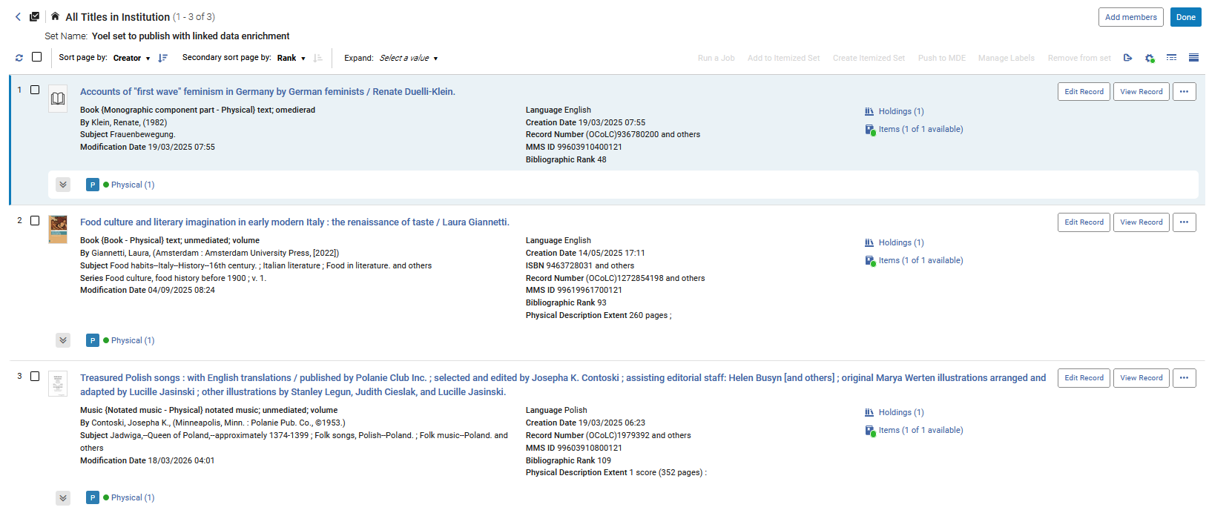
On the Fly Enrichment
The three records exist in set “Yoel set to publish with linked data enrichment”

Slide 18
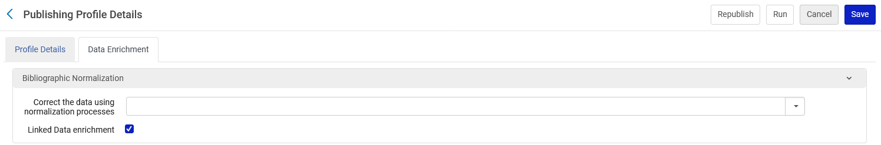
On the Fly Enrichment
In the publishing profile we have specified “Linked Data Enrichment”.
This means it will look at the Linked Data Enrichment tables to add the relevant URIs in the relevant subfields in accordance with the Linked Data Enrichment tables

Slide 19
On the Fly Enrichment
We will look at the output of the publishing profile as a mrk file (converted from .mrc to .mrk using “MarcBreaker in MarcEdit). This is merely for the purposes of being able to easily visualize the addition of the URIs in the record for this presentation.
We will compare the output of the Publishing Profile with the Linked Data Enrichment with the record in Alma.

Slide 20
On the Fly Enrichment
We will see that URIs with identifiers get added to the bibliographic headings.
The text before the identifier in the URIs comes from the “Authority URI” field in the Linked Data Enrichment tables for names and subjects

Slide 21
On the Fly Enrichment
Before we run the publishing profile, we are taking note that the records in the repository do not have the linked data enrichment in subfields 0 or 1 for any of the specified vocabularies.
This means that any added linked data enrichment in subfields 0 or 1 for any of the specified vocabularies in the output file of the publishing profile are coming from the linked eda5ta enrichment and not from the original record

Slide 22
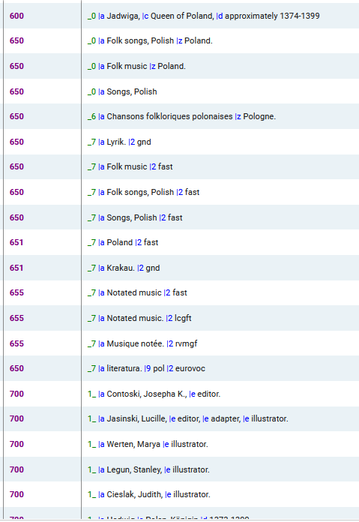
On the Fly Enrichment
  Treasured Polish songs : with English translations (MMS ID 99603910800121)
We see no subfields 0 or 1 in the headings

Slide 23
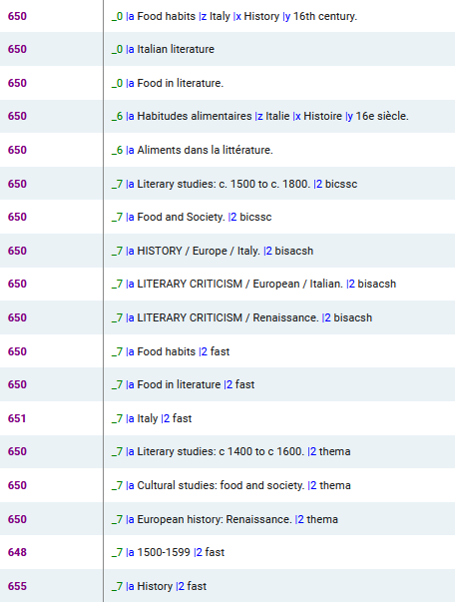
On the Fly Enrichment
  Food culture and literary imagination in early modern Italy : the renaissance of taste / Laura Giannetti. (MMS ID 99619961700121)
We see no subfields 0 or 1 in the headings

Slide 24
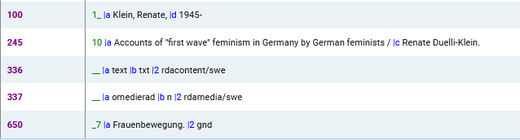
On the Fly Enrichment
  Accounts of "first wave" feminism in Germany by German feminists / Renate Duelli-Klein. (MMS ID 99603910400121)
We see no subfields 0 or 1 in the headings

Slide 25
On the Fly Enrichment
We will now run the publishing profile “Add Linked Data Enrichment on the fly”.
This profile uses the set Yoel set to publish with linked data enrichment “Yoel set to publish with linked data enrichment”.
This is the set which has the three records we looked at here.

Slide 26
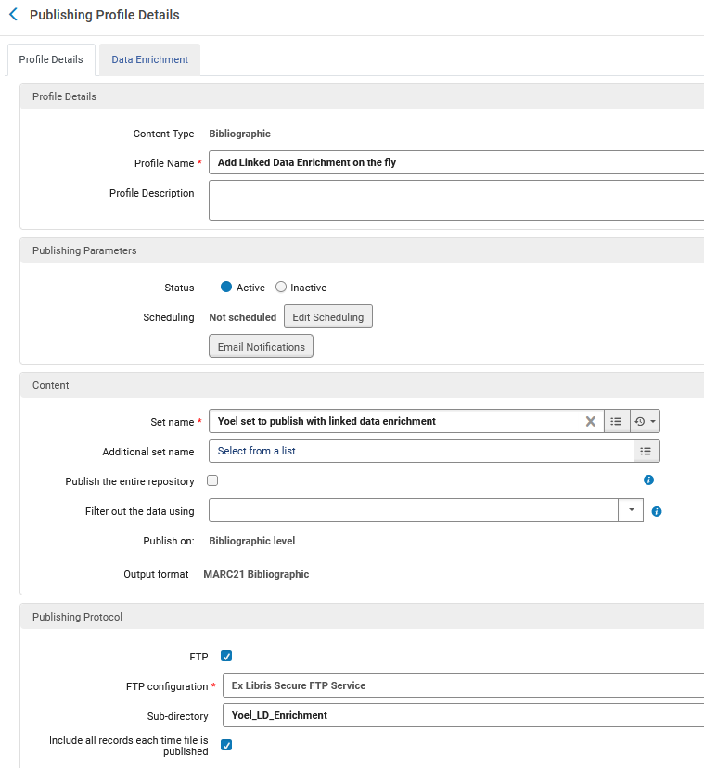
On the Fly Enrichment
Here is the “Profile Details” tab of the publishing profile
When the publishing completes, we will take the file from the FTP server
We are publishing to MARC21 Bibliographic format

Slide 27
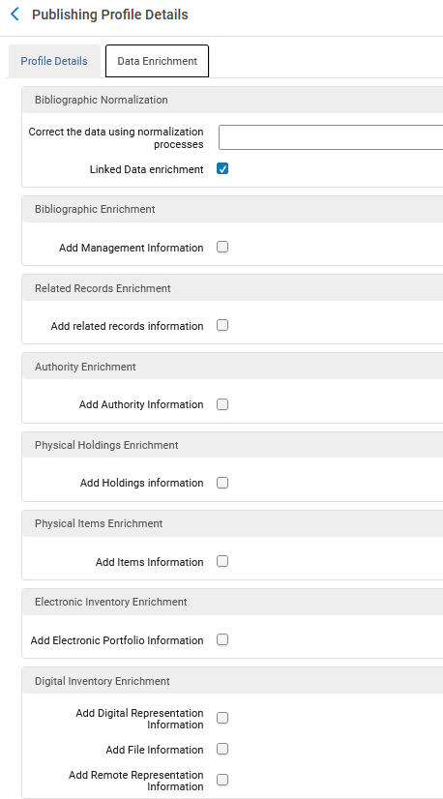
On the Fly Enrichment
Here is the “Data Enrichment” tab of the publishing profile
We have chosen “Linked Data Enrichment”

Slide 28
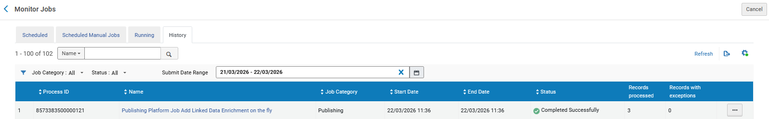
On the Fly Enrichment
The publishing profile has successfully completed on the three records in the set

Slide 29
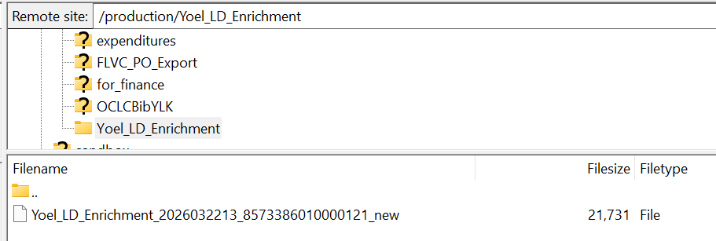
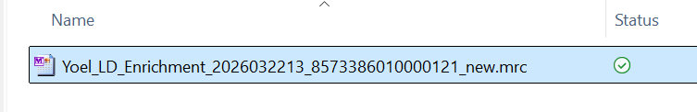
On the Fly Enrichment
The output of the publishing profile has successfully arrived to the FTP server
We will move this to the PC and investigate
On the PC we have given the file a “.mrc” suffix and will view with MarcEditor.

Slide 30
On the Fly Enrichment
Title “Treasured Polish songs : with English translations”
For title Treasured Polish songs : with English translations (MMS ID 99603910800121) we have these fields (among others) in the output.
The yellow (LOC) and turquoise (VIAF) and pink (GND) and grey (EUROVOC) subfields were added via the Linked Data Enrichment
=600 \0$aJadwiga,$cQueen of Poland,$dapproximately 1374-1399$0http://id.loc.gov/authorities/names/n84211694$1http://viaf.org/viaf/268484049
=650 \0$aFolk songs, Polish$zPoland.$0http://id.loc.gov/authorities/subjects/sh2008120844
=650 \0$aFolk music$zPoland.$0http://id.loc.gov/authorities/subjects/sh2008120804
=650 \0$aSongs, Polish$0http://id.loc.gov/authorities/subjects/sh88006840
=650 \7$aLyrik.$2gnd$0https://d-nb.info/040367746
=651 \7$aKrakau.$2gnd$0https://d-nb.info/040737608
=650 \7$aliteratura.$9pol$2eurovoc$0http://eurovoc.europa.eu/1680
=700 1\$aContoski, Josepha K.,$eeditor.$0http://id.loc.gov/authorities/names/n83231616$1http://viaf.org/viaf/43225981
=700 1\$aJasinski, Lucille,$eeditor,$eadapter,$eillustrator.$0http://id.loc.gov/authorities/names/no2010041179$1http://viaf.org/viaf/108052591
=700 1\$aWerten, Marya$eillustrator.$0http://id.loc.gov/authorities/names/no2010041285$1http://viaf.org/viaf/91860108
=700 1\$aLegun, Stanley,$eillustrator.$0http://id.loc.gov/authorities/names/no2010041211$1http://viaf.org/viaf/167249183
=700 1\$aCieslak, Judith,$eillustrator.$0http://id.loc.gov/authorities/names/no2010041159$1http://viaf.org/viaf/108052429
=700 1\$aHedwig$cPolen, Königin$d1373-1399$0https://d-nb.info/118709496$1http://viaf.org/viaf/3570159477664627990005
=710 2\$aPolanie Club (Minneapolis, Minn.),$epublisher.$0http://id.loc.gov/authorities/names/no2004004562$1http://viaf.org/viaf/132874734

Slide 31

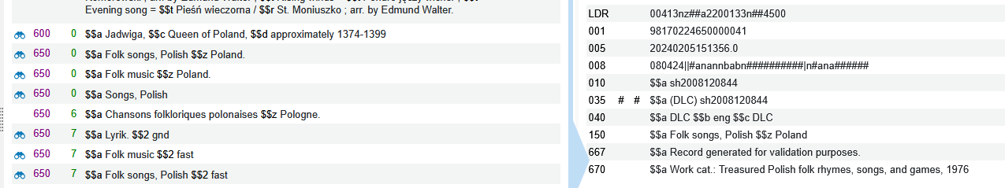
On the Fly Enrichment
Title “Treasured Polish songs : with English translations”
Got published as:
=650 \0$aFolk songs, Polish$zPoland.$0http://id.loc.gov/authorities/subjects/sh2008120844
This is an LCSH heading. The identifier sh2008120844 came from here:

Slide 32
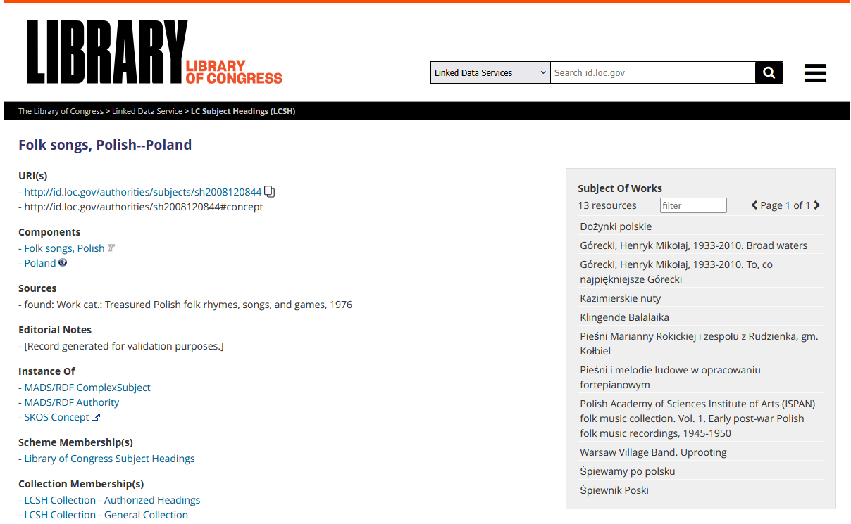
On the Fly Enrichment
This is URI http://id.loc.gov/authorities/subjects/sh2008120844

Slide 33
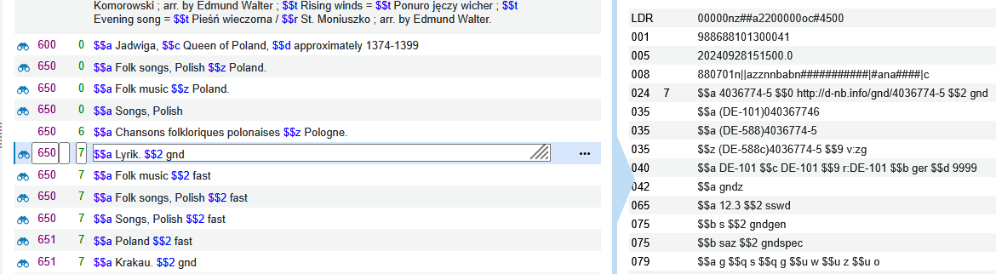
On the Fly Enrichment
Title “Treasured Polish songs : with English translations”
Got published as:
=650 \7$aLyrik.$2gnd$0https://d-nb.info/040367746
This is a GND heading. The identifier 040367746 came from here:

Slide 34
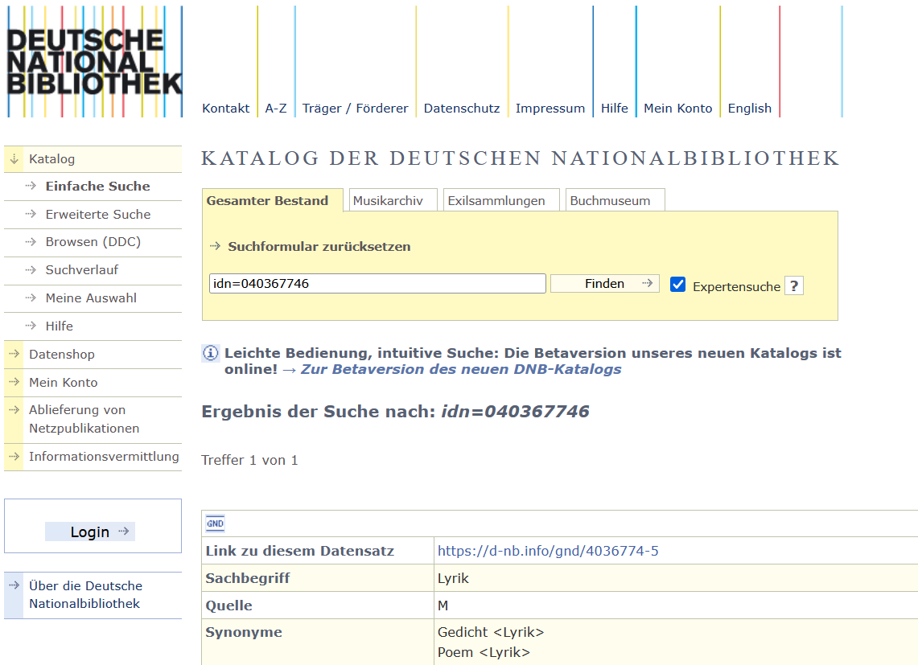
On the Fly Enrichment
This is URI https://d-nb.info/040367746

Slide 35
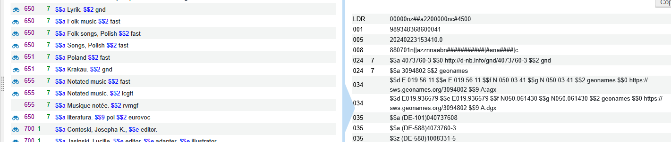
On the Fly Enrichment
Title “Treasured Polish songs : with English translations”
Got published as:
=651 \7$aKrakau.$2gnd$0https://d-nb.info/040737608
This is a GND heading. The identifier 040737608 came from here:

Slide 36
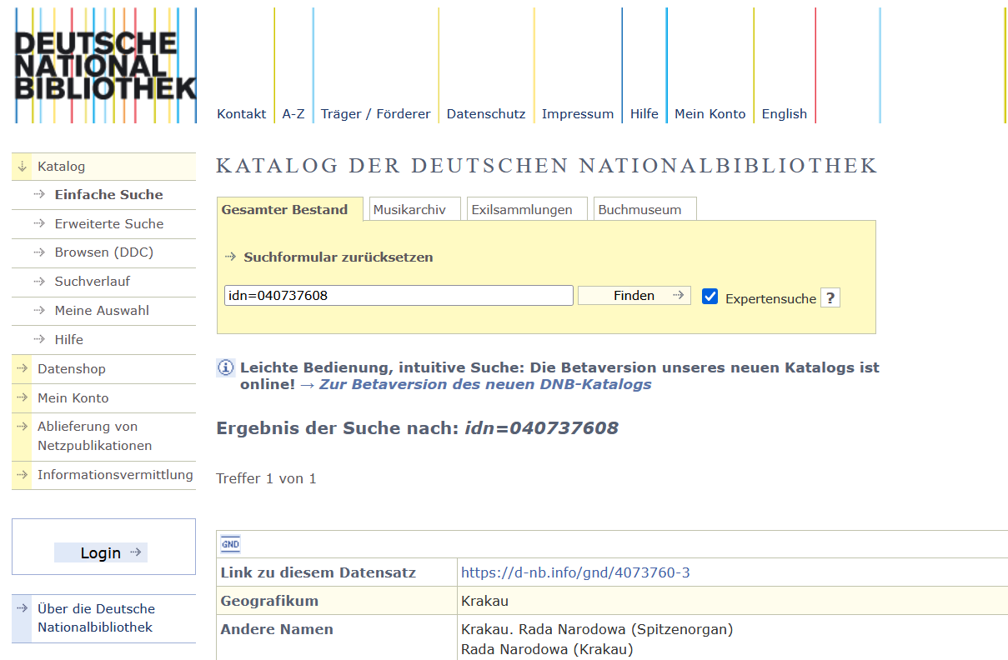
On the Fly Enrichment
This is URI https://d-nb.info/040737608

Slide 37
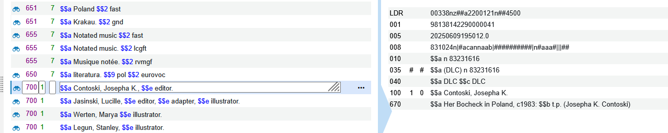
On the Fly Enrichment
Title “Treasured Polish songs : with English translations”
Got published as:
=700 1\$aContoski, Josepha K.,$eeditor.$0http://id.loc.gov/authorities/names/n83231616$1http://viaf.org/viaf/43225981
This is an LCNAMES heading. The identifier n83231616 came from here:

Slide 38
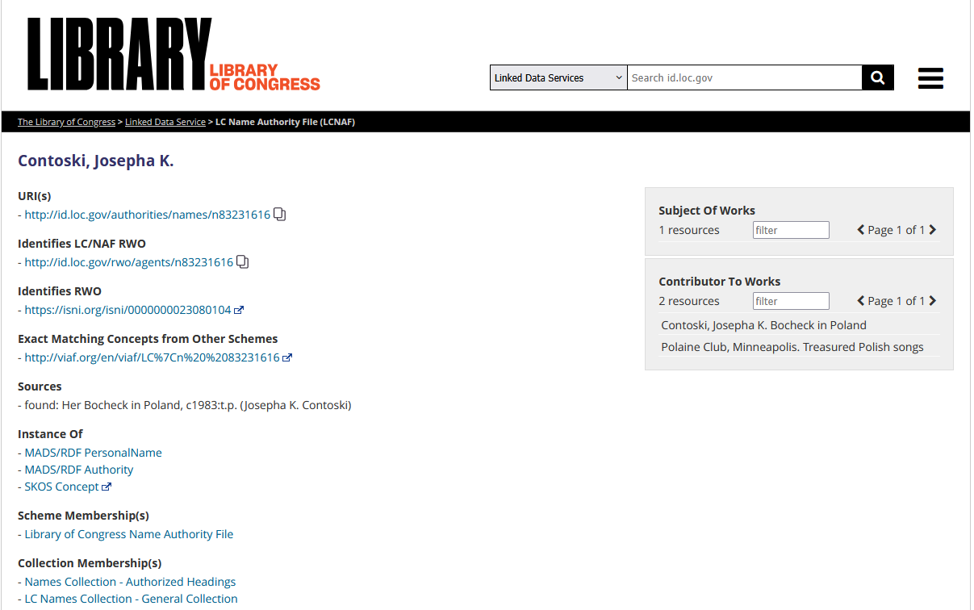
On the Fly Enrichment
This is URI http://id.loc.gov/authorities/names/n83231616

Slide 39
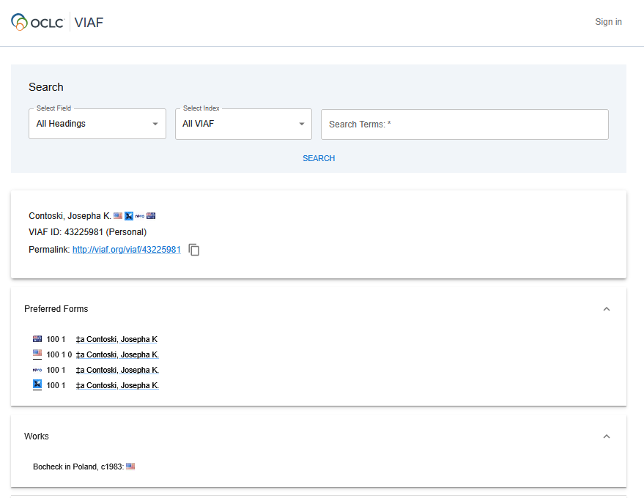
On the Fly Enrichment
This is URI http://viaf.org/viaf/43225981

Slide 40
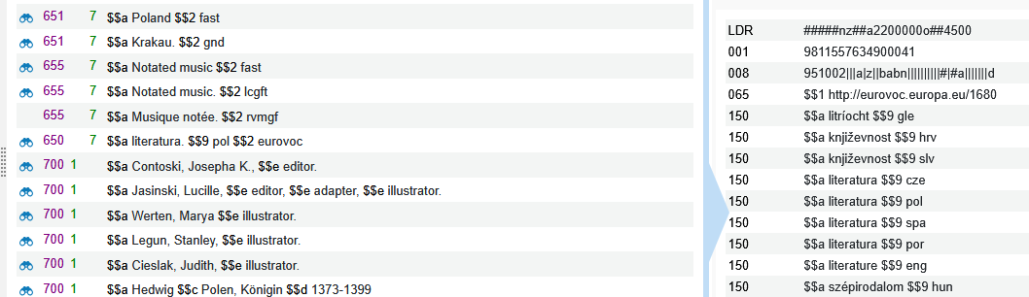
On the Fly Enrichment
Title “Treasured Polish songs : with English translations”
Got published as:
=650 \7$aliteratura.$9pol$2eurovoc$0http://eurovoc.europa.eu/1680
This is a EUROVOC heading. The identifier 1680 came from here:

Slide 41
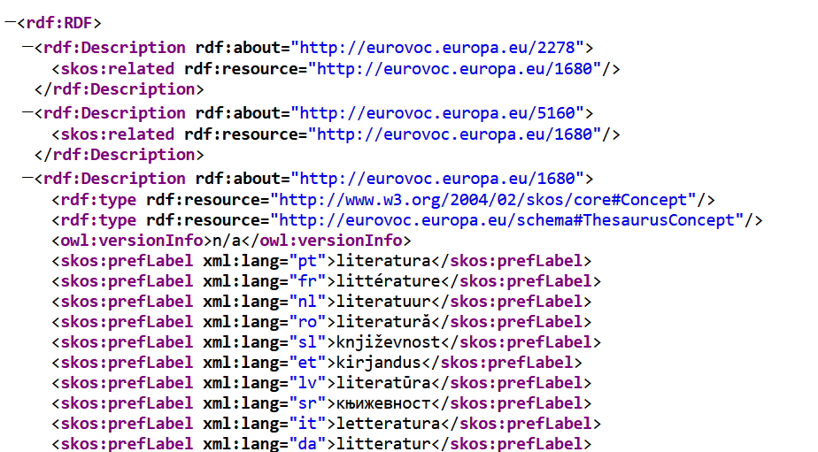
On the Fly Enrichment
This is URI http://eurovoc.europa.eu/1680

Slide 42
On the Fly Enrichment
Title “Food culture and literary imagination in early modern Italy”
For title Food culture and literary imagination in early modern Italy (MMS ID 99619961700121) we have these fields (among others) in the output.
The yellow (LOC) and turquoise (VIAF) subfields were added via the Linked Data Enrichment
=100 1\$aGiannetti, Laura,$eauthor.$0http://id.loc.gov/authorities/names/n2002038409$1http://viaf.org/viaf/55970241
=650 \0$aFood habits$zItaly$xHistory$y16th century.$0http://id.loc.gov/authorities/subjects/sh85050275
=650 \0$aItalian literature$0http://id.loc.gov/authorities/subjects/sh85068816
=650 \0$aFood in literature.$0http://id.loc.gov/authorities/subjects/sh85050279

Slide 43
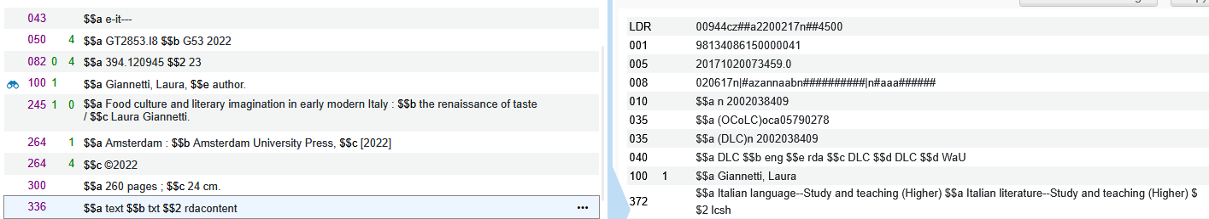
On the Fly Enrichment
Title “Food culture and literary imagination in early modern Italy”
Got published as:
=100 1\$aGiannetti, Laura,$eauthor.$0http://id.loc.gov/authorities/names/n2002038409$1http://viaf.org/viaf/55970241
This is an LCNAMES heading. The identifier n2002038409 came from here:

Slide 44
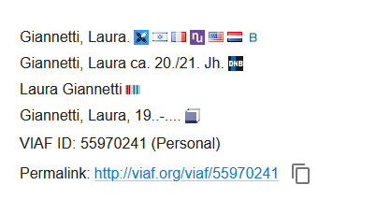
On the Fly Enrichment
Title “Food culture and literary imagination in early modern Italy”
Got published as:
=100 1\$aGiannetti, Laura,$eauthor.$0http://id.loc.gov/authorities/names/n2002038409$1http://viaf.org/viaf/55970241
This is an LCNAMES heading. Here is (the beginning of) the VIAF link viewed in a browser:

Slide 45
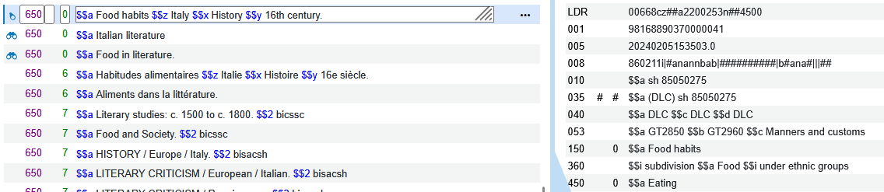
On the Fly Enrichment
Title “Food culture and literary imagination in early modern Italy”
Got published as:
=650 \0$aFood habits$zItaly$xHistory$y16th century.$0http://id.loc.gov/authorities/subjects/sh85050275
This is a LCSH heading. The identifier sh85050275 came from here:

Slide 46
On the Fly Enrichment
Title “Accounts of "first wave" feminism in Germany by German feminists”
For title Accounts of "first wave" feminism in Germany by German feminists (MMS ID 99603910400121) we have these fields (among others) in the output.
The yellow (LOC) and turquoise (VIAF) ) and pink (GND) subfields were added via the Linked Data Enrichment
=100 1\$aKlein, Renate,$d1945-$0http://id.loc.gov/authorities/names/n82088057$1http://viaf.org/viaf/108299501
=650 \7$aFrauenbewegung.$2gnd$0https://d-nb.info/040714284

Slide 47
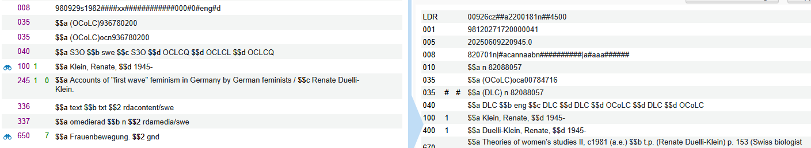
On the Fly Enrichment
Title “Accounts of "first wave" feminism in Germany by German feminists”
Got published as:
=100 1\$aKlein, Renate,$d1945-$0http://id.loc.gov/authorities/names/n82088057$1http://viaf.org/viaf/108299501
This is an LCNAMES heading. The identifier n82088057 came from here:

Slide 48
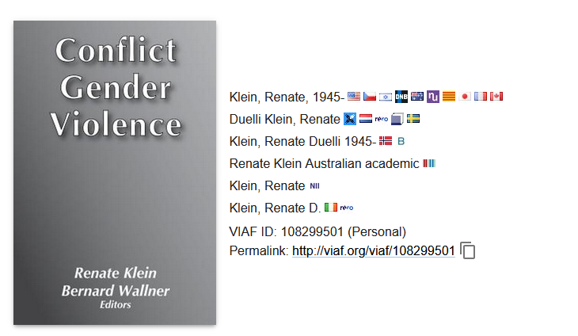
On the Fly Enrichment
Title “Accounts of "first wave" feminism in Germany by German feminists”
Got published as:
=100 1\$aKlein, Renate,$d1945-$0http://id.loc.gov/authorities/names/n82088057$1http://viaf.org/viaf/108299501
This is an LCNAMES heading. Here is (the beginning of) the VIAF link viewed in a browser:

Slide 49
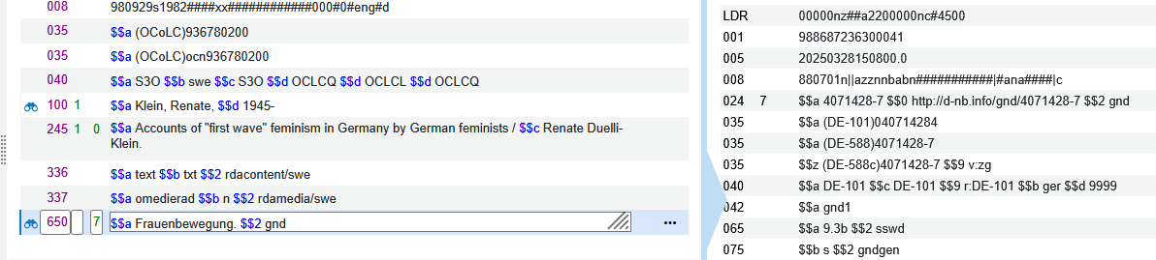
On the Fly Enrichment
Title “Accounts of "first wave" feminism in Germany by German feminists”
Got published as:
=650 \7$aFrauenbewegung.$2gnd$0https://d-nb.info/040714284
This is a GND heading. The identifier 040714284 came from here:

Slide 50
On the Fly Enrichment
Note that when using the “On the Fly Enrichment” the records in Alma are not updated
Only the records in the published file are updated with the Linked Data URIs.

Slide 51
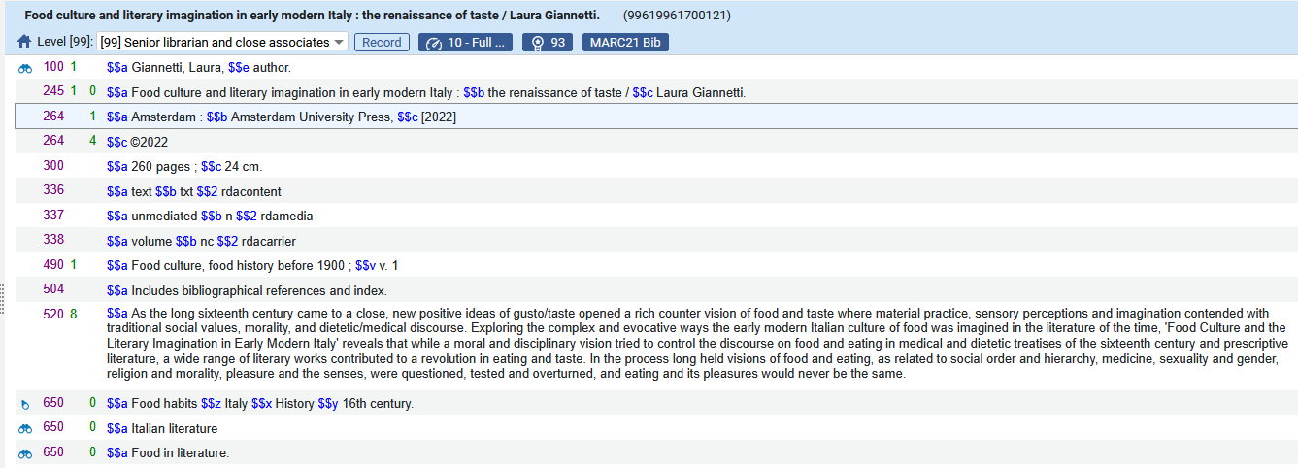
On the Fly Enrichment
For example, here is title “Food culture and literary imagination in early modern Italy (MMS ID 99619961700121)
The record in the Alma repository was not updated with the Linked Data URIs. The Linked Data URIs were only added to the published file

Slide 52
Permanent Enrichment

Slide 53
Permanent Enrichment
We will now do an example of “Permanent” enrichment.
In order to see how it works we will do as follows:
  See our definitions for “Linked Data Enrichment – Names” and “Linked Data Enrichment – Subjects”
  Look at two records and see that there are no linked data URI’s in the records (we will use two of the same examples we used for “On the Fly” enrichment)
  For the first record update the bibliographic heading(s) via “Open Authority Headings (F3)”
  For the second record update the bibliographic heading(s) by unlinking the headings and letting the jobs “Authorities - Link BIB Headings” and “Authorities - Preferred Term Correction” run
  See that the URIs have been added to the records in the repository.

Slide 54
Permanent Enrichment
Here is what we have defined for “Linked Data Enrichment – Names”.
Relevant rows of the table appear on the next slide
For vocabulary code GND (Deutschen Nationalbibliothek) we are adding the URI to subfield 0 and adding the VIAF link to subfield 1.
  We are using authority URI https://d-nb.info/gnd/{0} (the value in the curly brackets is the identifier of the authority record)
For vocabulary code LCNAMES (Library of Congress Names) we are adding the URI to subfield 0 and adding the VIAF link to subfield 1
  We are using authority URI http://id.loc.gov/authorities/names/{0} (the value in the curly brackets is the identifier of the authority record)

Slide 55
Permanent Enrichment
Here is what we have defined for “Linked Data Enrichment – Names”.
The Enrichment Type is “Permanent” for both Vocabulary Source Codes

Slide 56
Permanent Enrichment
Here is what we have defined for “Linked Data Enrichment – Subjects”.
Relevant rows of the table appear on the next slide
For vocabulary code GND (Deutschen Nationalbibliothek) we are adding the URI to subfield 0
  We are using authority URI https://d-nb.info/gnd/{0} (the value in the curly brackets is the identifier of the authority record)
For vocabulary code LCSH (Library of Congress Subject Headings) we are adding the URI to subfield 0
  We are using authority URI http://id.loc.gov/authorities/subjects/{0} (the value in the curly brackets is the identifier of the authority record)
For vocabulary code EUROVOC (European Union Vocabularies) we are adding the URI to subfield 0
  We are using authority URI http://eurovoc.europa.eu/{0} (the value in the curly brackets is the identifier of the authority record)

Slide 57
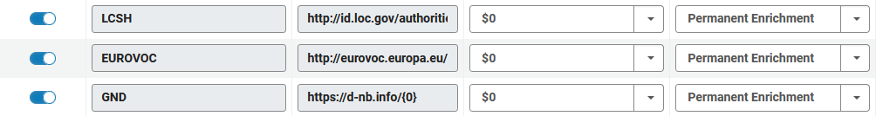
Permanent Enrichment
Here is what we have defined for “Linked Data Enrichment – Subjects”.
The Enrichment Type is “Permanent” for all three Vocabulary Source Codes

Slide 58
Permanent Enrichment
For this record:
  Treasured Polish songs : with English translations (MMS ID 99603910800121)
We will update the bibliographic heading(s) via “Open Authority Headings (F3)”
For this record
  Food culture and literary imagination in early modern Italy : the renaissance of taste / Laura Giannetti. (MMS ID 99619961700121)
We will update the bibliographic record(s) by unlinking the headings and letting the jobs “Authorities - Link BIB Headings” and “Authorities - Preferred Term Correction” run

Slide 59

Permanent Enrichment
Title “Treasured Polish Songs” has heading
650_0 $$a Folk songs, Polish $$z Poland.
Without a URI.
We will do “Open Authority Headings (F3)” on the heading

Slide 60
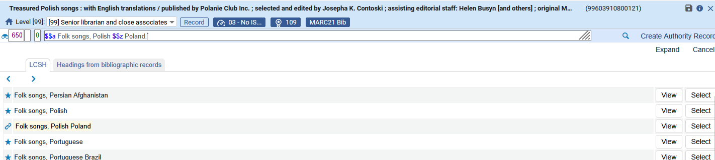
Permanent Enrichment
We will select the heading

Slide 61

Permanent Enrichment
We see that the URI gets added

Slide 62
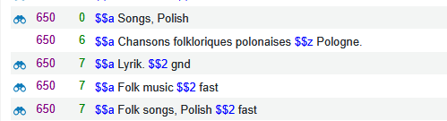
Permanent Enrichment
Title “Treasured Polish Songs” has heading
650_7 $$a Lyrik. $$2 gnd
Without a URI.
We will do “Open Authority Headings (F3)” on the heading

Slide 63
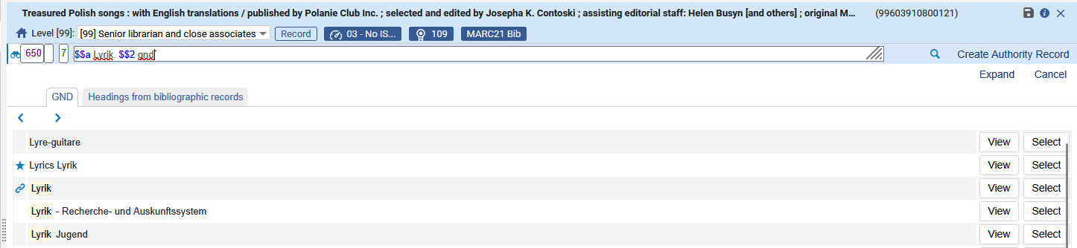
Permanent Enrichment
We will select the heading

Slide 64
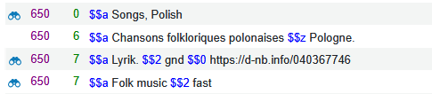
Permanent Enrichment
We see that the URI gets added

Slide 65
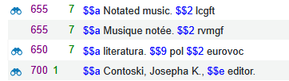
Permanent Enrichment
Title “Treasured Polish Songs” has heading
650_7 $$a literatura. $$9 pol $$2 eurovoc
Without a URI.
We will do “Open Authority Headings (F3)” on the heading

Slide 66
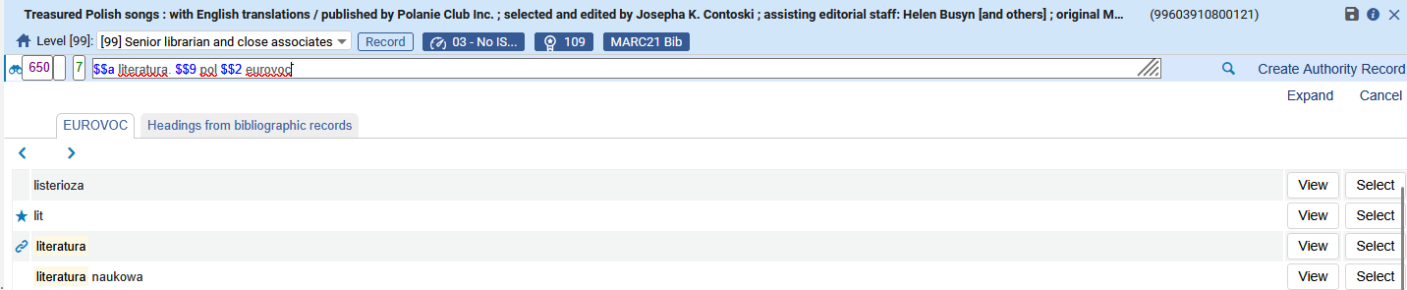
Permanent Enrichment
We will select the heading

Slide 67
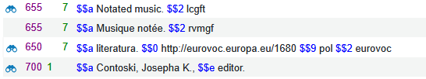
Permanent Enrichment
We see that the URI gets added

Slide 68
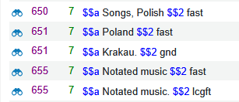
Permanent Enrichment
Title “Treasured Polish Songs” has heading
651_7 $$a Krakau. $$2 gnd
Without a URI.
We will do “Open Authority Headings (F3)” on the heading

Slide 69
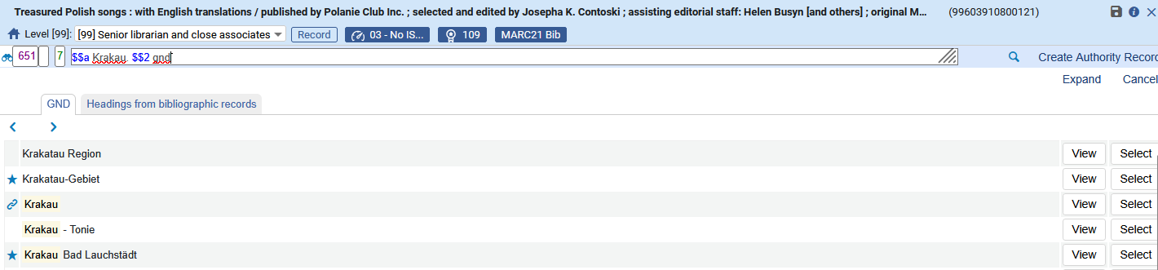
Permanent Enrichment
We will select the heading

Slide 70
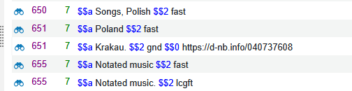
Permanent Enrichment
We see that the URI gets added

Slide 71
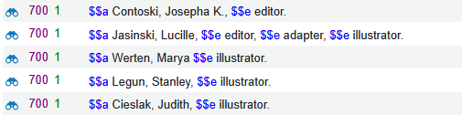
Permanent Enrichment
Title “Treasured Polish Songs” has heading
700_1 $$a Werten, Marya, $$e illustrator.
Without a URI. (it is linked to LCNAMES)
We will do “Open Authority Headings (F3)” on the heading

Slide 72
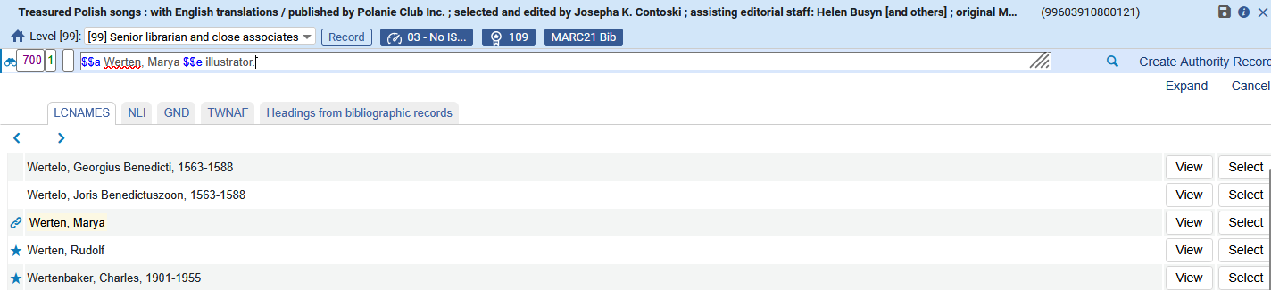
Permanent Enrichment
We will select the heading

Slide 73
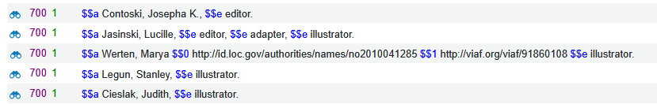
Permanent Enrichment
We see that the URIs get added

Slide 74
Permanent Enrichment
Now we will use title “Food culture and literary imagination in early modern Italy”.
The bibliographic headings have no URIs.
We will see that URIs get added when we update the bibliographic heading(s) by unlinking the headings and letting the jobs “Authorities - Link BIB Headings” and “Authorities - Preferred Term Correction” run

Slide 75
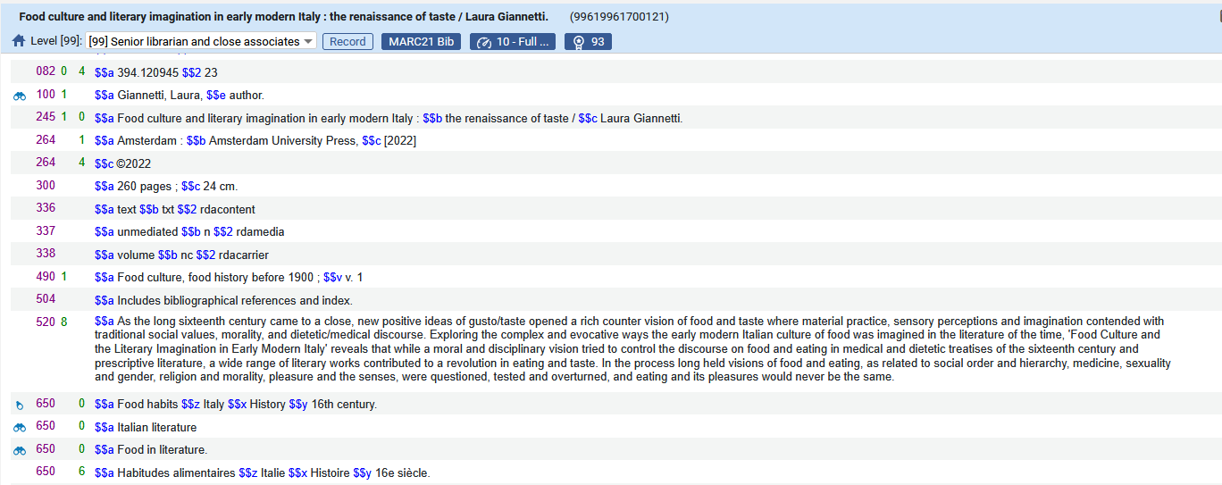
Permanent Enrichment
Title “Food culture and literary imagination in early modern Italy” has no URIs.

Slide 76
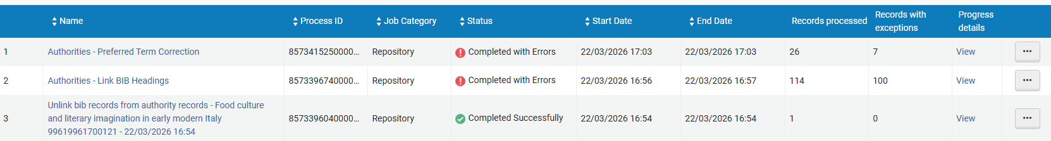
Permanent Enrichment
The job “Unlink bib records from authority records” is run on a set which contains “Food culture and literary imagination in early modern Italy”.
Then the scheduled jobs “Authorities - Link BIB Headings” and “Authorities - Preferred Term Correction” run.

Slide 77
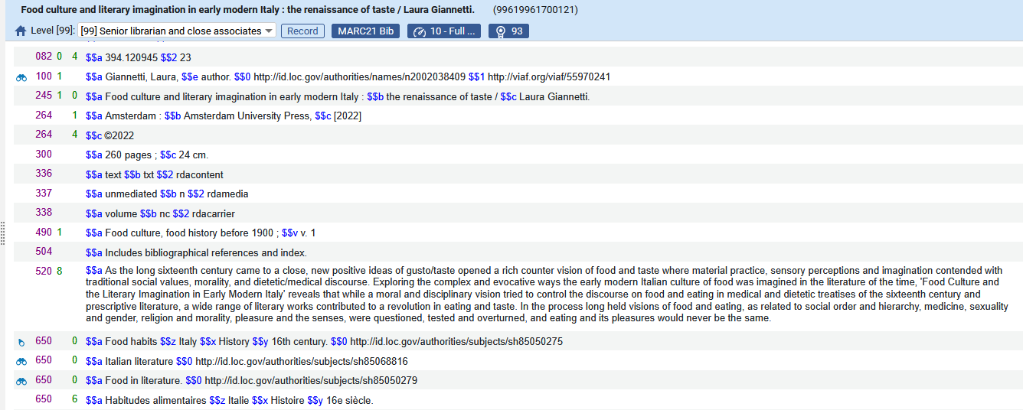
Permanent Enrichment
Now we see that URIs have been added to the record

Slide 78
Permanent Enrichment
Field
1001_ $$a Giannetti, Laura, $$e author.
Got these URIs:
$$0 http://id.loc.gov/authorities/names/n2002038409
$$1 http://viaf.org/viaf/55970241

Slide 79
Permanent Enrichment
Field
650_0 $$a Food habits $$z Italy $$x History $$y 16th century.
Got this URI:
$$0 http://id.loc.gov/authorities/subjects/sh85050275

Slide 80
Thank You

